Slide 1
Confirmation Bias
How it shapes our thinking and decision making

Slide 2
Defining Confirmation Bias
Define means to clearly state the term’s meaning

Slide 3
Explanation of confirmation bias
Definition of Confirmation Bias
  It is the tendency to favour information that supports existing beliefs while ignoring opposing information.
Impact on Perception
  This bias leads to reinforced preconceived notions without conscious awareness, affecting judgement.

Slide 4
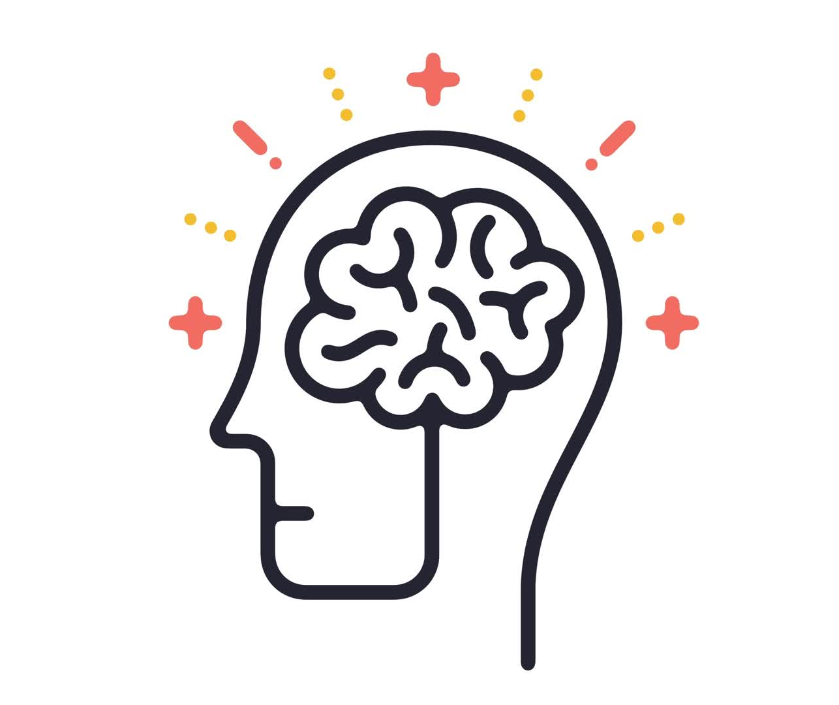
Origins and psychological background
Cognitive Heuristics
  Confirmation bias relates to cognitive shortcuts that simplify decision-making but can lead to errors.
Motivated Reasoning
  Our minds prefer consistent information to reduce cognitive dissonance and maintain beliefs.
  Cognitive dissonance – the discomfort of having conflicting / inconsistent ideas, for example… __________________

Slide 5
How Confirmation Bias Operates

Slide 6
Selective gathering of information
Confirmation Bias
  People prefer information that supports their pre-existing beliefs, leading to biased data selection.
Ignoring opposing views
  Opposing information is often undervalued or disregarded, reducing exposure to diverse perspectives.

Slide 7
Interpretation and recall of information
Biased (distorted) interpretation
  Individuals interpret ambiguous information to align with their existing attitudes and beliefs.
Memory reconstruction
  Memories are often reconstructed to fit existing beliefs, which can cause biased recall.

Slide 8
Examples
Political opinion bias
  People tend to favour news sources that match their political beliefs, reinforcing existing opinions, for example ________________
Social perception bias
  Preconceived notions affect how individuals interpret others’ behaviour in social settings, for example _________________.

Slide 9
Consequences of Confirmation Bias

Slide 10

Impact on decision making
Role of confirmation bias
  Confirmation bias causes individuals to focus only on information that supports their beliefs, ignoring contradictory evidence.
Effects on decision quality
  This bias leads to poor decisions by overlooking critical facts and alternative solutions in personal and professional settings.

Slide 11
Effects on group dynamics and polarisation
Confirmation bias in groups Confirmation bias strengthens existing beliefs by selectively accepting information that supports them.
Echo chambers formation Echo chambers form when group members only engage with like-minded opinions, reinforcing shared views.
Increased polarisation Polarisation occurs as groups reject opposing views, leading to more extreme, entrenched positions.
Hindered dialogue Polarisation and echo chambers hinder constructive dialogue and mutual understanding within groups.

Slide 12
Role in perpetuating stereotypes
Confirmation bias impact
Confirmation bias focuses attention on information that supports existing social group beliefs, strengthening stereotypes.
Stereotype maintenance
Stereotypes are maintained as confirmation bias filters out contradictory evidence, preserving prejudices.
Social inequality
Reinforced stereotypes contribute to social inequalities by perpetuating unjust attitudes towards groups.

Slide 13
Mitigating Confirmation Bias

Slide 14
Strategies for individuals
Seek diverse perspectives Actively exploring different viewpoints helps reduce confirmation bias and broadens understanding.
Question assumptions Challenging existing beliefs encourages open-mindedness and critical thinking.
Reflect critically Self-reflection fosters intellectual humility and awareness of personal biases.

Slide 15
Approaches in organisations
Structured Decision-Making
  Implementing clear and systematic decision-making processes reduces bias and improves organisational outcomes.
Encouraging Dissent
  Welcoming diverse and opposing viewpoints fosters critical thinking and challenges group consensus bias.
Training on Cognitive Biases
  Educating employees about cognitive biases helps recognise and counteract confirmation bias effectively.

Slide 16
Promoting Critical Thinking and Open-Mindedness
Encouraging critical thinking Critical thinking helps individuals analyse information deeply and make reasoned decisions.
Fostering open-mindedness Open-minded attitudes promote curiosity and reduce judgement when encountering new ideas.
Recognising biases Awareness of personal biases leads to more objective evaluation of information.

Slide 17
Conclusion
Understanding Confirmation Bias
Recognition of confirmation bias helps reveal how it influences perception and decision-making.
Mitigation Strategies
Applying strategies to reduce bias leads to clearer thinking and improved decision outcomes.
Inclusive Interactions
Reducing bias fosters more inclusive and respectful social relationships and interactions.

Slide 18
Examples:
1. Social media algorithms
2.
3.
Notes:
Confirmation bias profoundly shapes how we perceive and decide. By understanding its mechanisms and consequences, and adopting strategies to mitigate it, we can improve our thinking, make better decisions, and foster more inclusive social interactions.

